Slide 1
Cancer Biology Biol 445
Spring 2020
Dr. Heidi Super
Lecture 11
2-12-2020

Slide 2
Field trip!
I have arranged to visit Dr. Badie Alakech—a pathologist at Trinity Hospital.
February 19th
Plan to arrive by 11 am and stay until at least 11:50.
I will figure out our best meeting place and can drive up to 4 students there.
I will try to help us prepare some for the experience.

Slide 3
Where were we?
Angiogenesis and anti-angiogenic therapy
Why so much hope?
Why so much despair?

Slide 4
What else does a tumor need?
Your text does not provide much information about supporting cells/tissues beyond blood vessels.
Yet most tumors are a mixture of cancer cells and non-tumor supporting cells---collectively called tumor-associated stroma.

Slide 5
As mentioned earlier, tumor cells secrete a variety of factors---some recruit cells from the host to serve a variety of functions as stroma.
Tumors must establish themselves much like a tissue forming during embryogenesis/fetal development.
Require cells which anchor, shape and protect the actual tumor cells.

Slide 6
Some support/stromal cells are called in from different sights by chemicals which cause migration.
E.g. Chemokines
Macrophages respond to tumor-produced chemokines and migrate to the area much as they do in an immune respose.

Slide 7
Once at the tumor site, stromal cells respond to other tumor-derived chemicals which cause them to organize and/or mature.
E.g. cytokines---special types of growth factors, cause cells surrounding the tumor or newly recruited cells to begin to divide or differentiate.

Slide 8
Chemokine and cytokine signaling is an essential aspect of immune responses too!
(Recall it was thought initially that angiogenesis was due to an immune response).
The tumor, along with all supporting tissue/cells is known as the tumor microenvironment.

Slide 9
Tumor microenvironment is very diverse.

Slide 10
Speculate on what cells like macrophages and lymphocytes may be doing in the tumor microenvironment?

Slide 11
How do we study the tumor and its microenvironment?
One method is histology. Taking thin slices of the tumor and studying the cells under the microscope.
Pathologists (like Dr. Alakech) make and analyze histology slides to help make diagnosis of abnormal cells.

Slide 12
The following few slides use a staining technique called Hematoxylin and eosin staining (H and E) of the tissues.
Hematoxylin turns the nuclei purple
Eosin stains various intracellular or extracellular proteins pink

Slide 13
H and E alone

Slide 14
Lots can be analyzed with this fairly easy to do technology.
Note cell shapes, sizes, and organization in a tissue.
Compare to known “normal” shapes, sizes, and organization of tissue or compare to a different tissue (e.g. outside the tumor area) from the same person.
Hypertrophy, hyperplasia, dysplasia, neoplasia can be identified

Slide 15
More advanced techniques….
We can recognize the tumor and non-tumor supporting cells, by staining for cell-specific molecules---immunostaining.
Immunostaining uses antibodies to specific molecules to distinguish different cell types.
The antibody sticks to the cell(s) and has a connected molecule that can be made to fluoresce or to turn color.

Slide 16
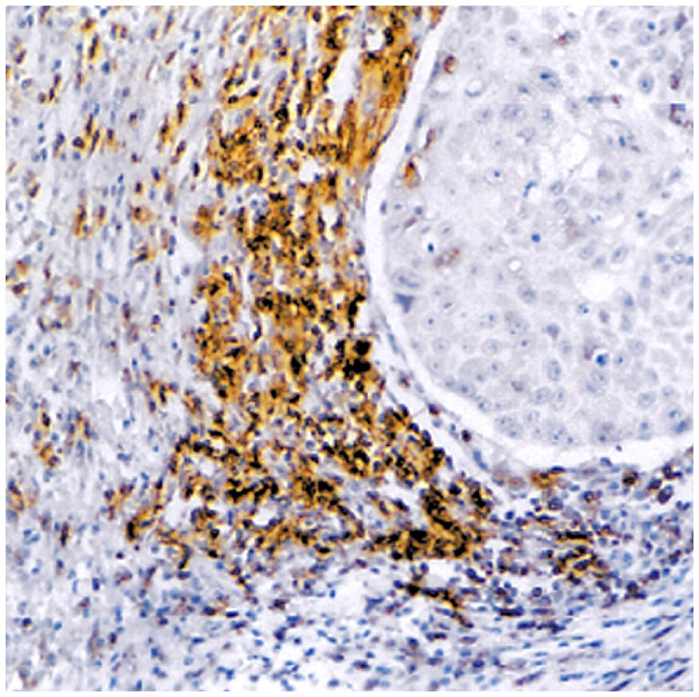
H and E + immunostaining
Brown-staining T-cells in a lung carcinoma
What’s going on here?---immune system cells accumulating at a lung tumor?

Slide 17
The brown areas are due to a chemical reaction involving a compound bound to a specific T-cell binding antibody.
(The technology is immunohistochemistry)

Slide 18
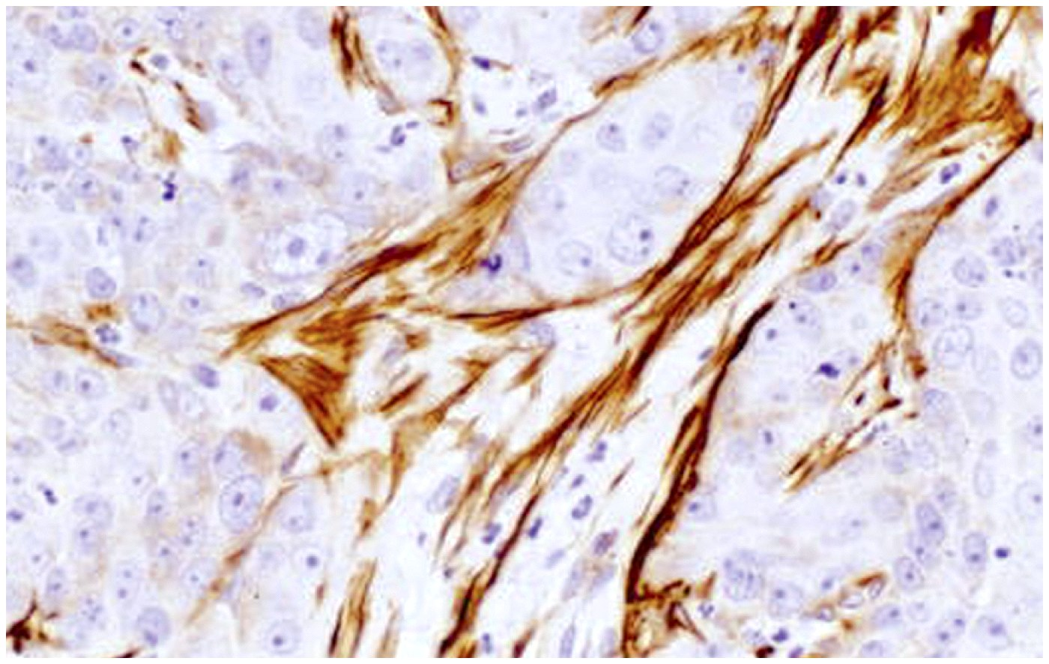
Brown-staining muscle fibers supporting a breast carcinoma
A different antibody used here to detect muscle cells rather than T-cells

Slide 19
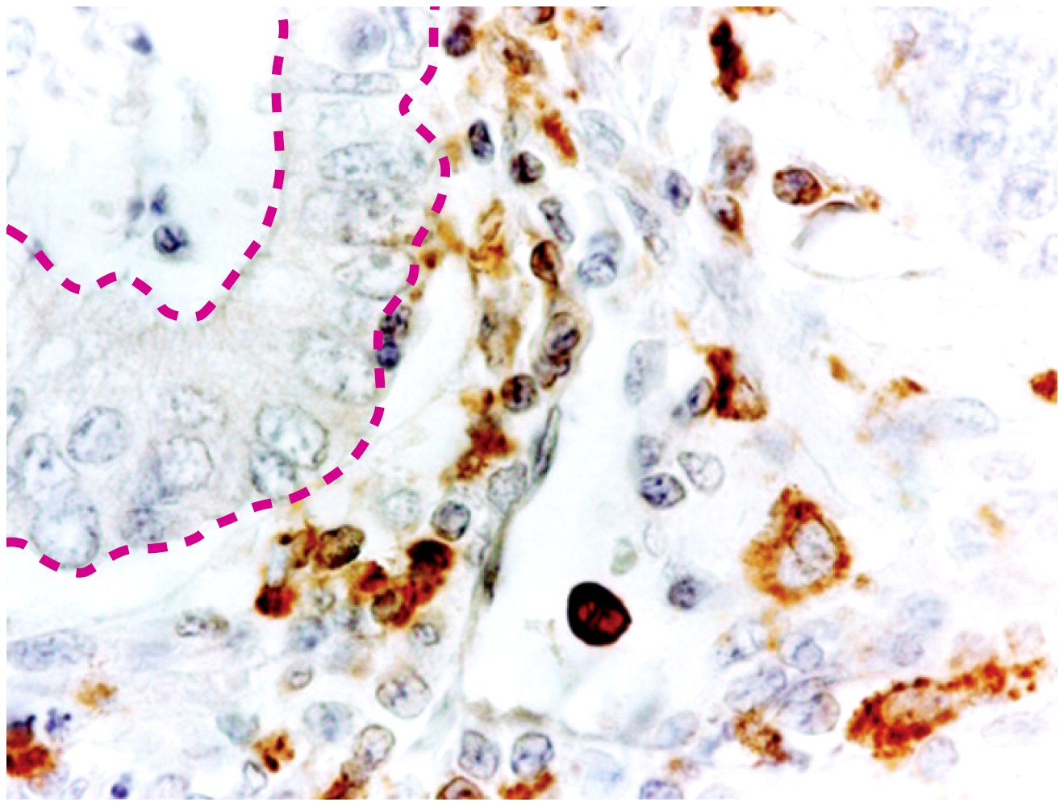
Stromal adipose cells supporting colon adenocarcinoma
Monocytes in the same colon cancer

Slide 20
What we’ve learned from immunohistochemistry
Tumors are rather heterogeneous at the cellular level.
This has complicated study of solid tumors at times. Biopsy of tumors results in a mix of cells, some of which show cancer-associated DNA changes (the tumor cells) ,but most of which are genetically unchanged (the stromal cells)!

Slide 21
Onward…!
Recall---even a tumor of significant size, and which is established at its primary site, is relatively harmless.

Slide 22
Tumor progression—part II
Following establishment of blood vessels and stromal support, tumors progress and spread in a multistep process.
2 distinct, but interdependent mechanisms
Invasion
Metastasis

Slide 23
Tumor cells become invasive when they breach the extent of the primary tumor, and migrate beyond a tissue barrier.
At the molecular level, this results from a loss of normal cell-cell contact via cell adhesion molecules
Eg. E-cadherin (often found in lower levels in cancer cells compared to normal cells.) Normally helps cells maintain cell-cell contact.

Slide 24
Invasion requires some level of cell motility.
Most cells are not normally motile (exceptions—macrophages)
Cancer cells gain motility via signals from surroundings and begin to express genes associated with motility

Slide 25
Finally--cell invasiveness requires actual breakdown of barriers.
Expression of enzymes which degrade:
Barriers such as basil lamina—the protein layers that form a boundary between epithelial tissues and surroundings.
The network of proteins called extracellular matrix (ECM)

Slide 26
Proteases
Enzymes that digest proteins are called proteases (recall MMPs). Proteases are often produced by cells in an inactive form. (Like many proteins, they aren’t needed often, but when they are they need to act quickly.)
Tumors tend to secrete a lot of a protease activator, plasminogen activator.

Slide 27
Figure 3.9
Plasminogen activator—contributes greatly to invasion and metastasis.
Cleaves Plasminogen to produce Plasmin. (Which is a protease that digests components of the basil lamina and ECM).
Also cleaves inactive matrix metalloproteinases to create active forms.

Slide 28
Recall matrix (extracellular matrix) metalloproteinases
These same MMPs are important in breaking down regions of existing blood vessels and sprouting new ones. (Angiogenesis)

Slide 29
Interesting…
Cells of most tissues also produce proteins known as protease inhibitors.
Similar to angiogenesis, events related to metastasis require a competition between tumor and stroma derived tumor promoters (MMPs) and host/tissue derived tumor inhibitors.

Slide 30
Putting all factors together…
A cell that:
Looses its grip on its neighbors
Gains the ability to move
Gains the ability to eat through its environment
Will eventually make its way to the newly formed blood vessels or lymphatic vessel in its immediate area.

Slide 31
Cancer cells which enter the bloodstream, travel to secondary sites and become established using the same mechanisms as the primary tumor did.
This is Metastasis. Figure 3-8

Slide 32
Figure 3-11
Metastasis is not completely random—in terms of tumor cell path. Tumor cells will enter a lymphatic vessel or blood vessel nearby and be transported in the same direction as the blood/lymph in that area.

Slide 33
Gastrointestinal tumor cells metastasize to liver often.
Lung tumor cells can metastasize nearly any where in the body.
Breast tumor cells often metastasize to nearest lymph node.

Slide 34
Not all tumor cells are good at metastasizing
We’ve already mentioned a tumor microenvironment. (Tumor cells + non-tumor stroma and other cells)
Even the actual tumor cells show a significant degree of variation.

Slide 35
Figure 3-10
Metastatic tumors show enhanced ability to metastasize. The tumors that grow at a secondary site, have the characteristics to metastasize already.
Similar to tumor stem cells/metastasis-ready cells.

Slide 36
Scientists have built careers on the study of metastasis. Like angiogenesis, the control of metastasis is an ideal approach to “curing cancer”.
IMPORTANT CONCEPT
Without metastasis, cancer is not life threatening, in most cases.
Metastasis is not specific to any one type of cancer.
Targeting metastasis does not require killing every single cancer cell

Slide 37
First “Anti-metastasis” approach focused in MMP inhibitors
There is a more general interest in MMPs in other diseases.
(Some other diseases are the result of MMP overexpression)

Slide 39
Unfortunately, MMP inhibitors, like angiogenesis inhibitors have not been very successful in human cancer treatment.

